Slide 1



Inferring Metapopution Propagation Network for Intra-city Epidemic Control and Prevention
Jingyuan Wang, Beihang University
J. Wang, X. Wang, J. Wu. Inferring Metapopulation Propagation Network for Intra-city
Epidemic Control and Prevention. KDD, Applied Data Science Track, London, 2018.

Slide 2
CONTENT
1
Motivations
2
Model Construction
3
Network Inference
4
Data Description
5
Experiments
6
Conclusions
7
Extensions

Slide 3
Motivations
ONE

Slide 4
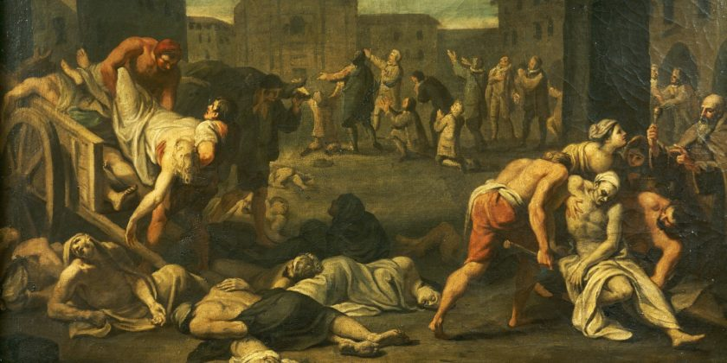
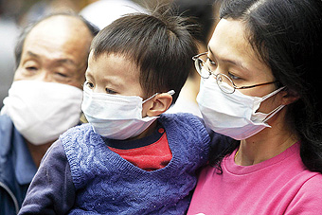
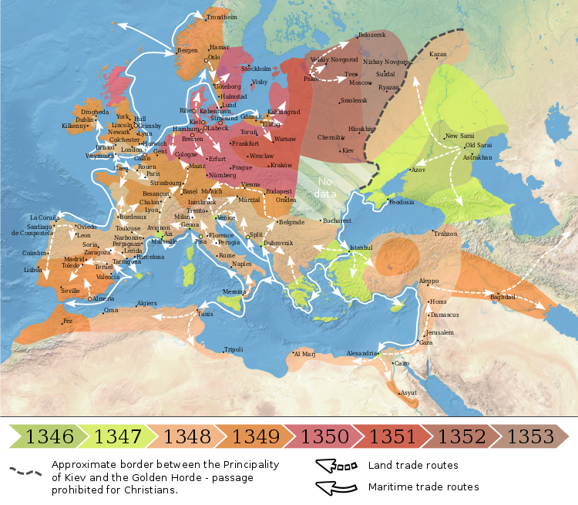
Background
Infectious diseases are serious threats to human life and health.
In History
In Recent Years
Epidemic transmitted via droplets: SARS 2003，H1N1 2009，H7N9 2013，H3N2 2017……
Black Death resulting in the deaths of 75 to 200 million people from 1347 to 1351.
The WHO estimates that annual flu epidemics result in about 290,000 to 650,000 deaths globally.

Slide 5
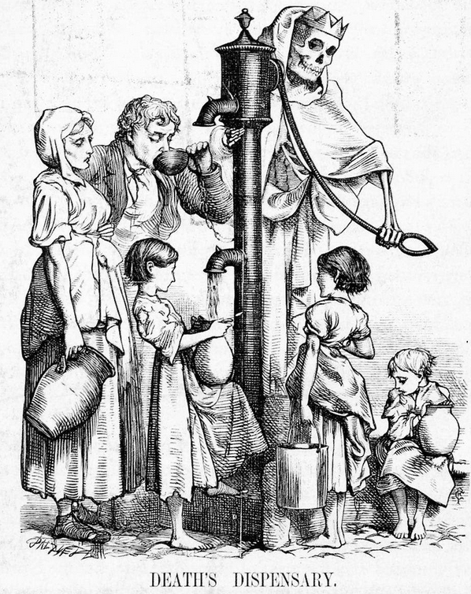
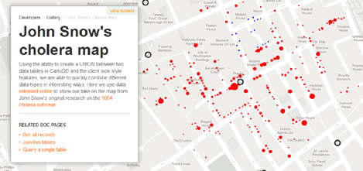
Related Work
Disease transmission has close relationship with human mobility!
The first work using data analysis to study epidemic:
John Snow’s London Cholera Map, 1854

Slide 6
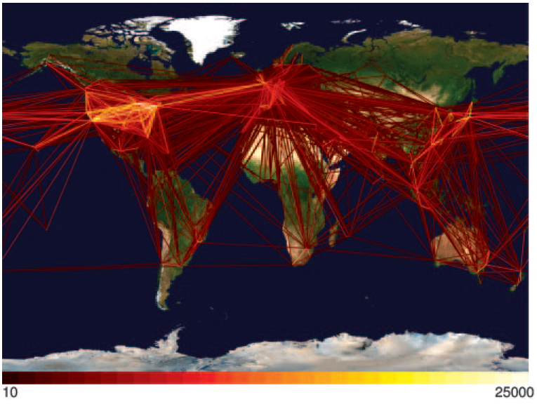
Related Work
Using metapopulation to model epidemic propagation. [PNAS04, Science13]
Global Propagation
Inter-city: along the worldwide aviation network.
Sub-pop m
Sub-pop n
Intra-city: “well-mixed” sub-populations

Slide 7
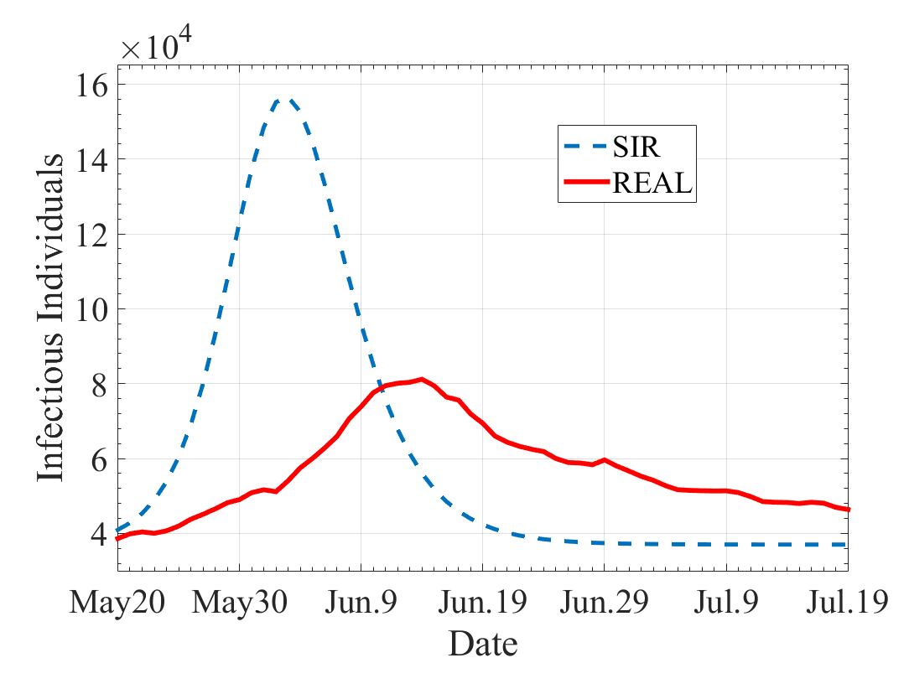
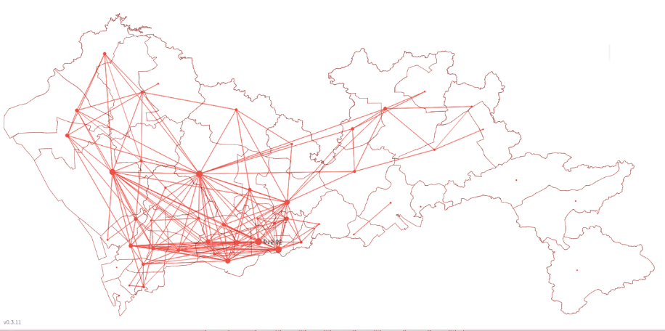
Motivation
However, in the real-word, intra-city propagation is more complicated…
Q1: Shall we use meta-population to model intra-city epidemic?
Well-mixed
Real Break
Obviously overestimate the outbreak speed and underestimate the duration.
Q2: How to figure out the propagation network inside a city?

Slide 8
Model Construction
TWO

Slide 9
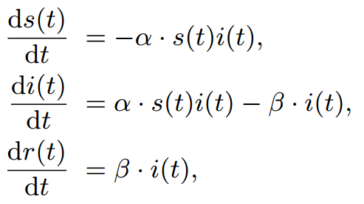
SIR Model
The SIR model is often used to describe the epidemic process.

Slide 10
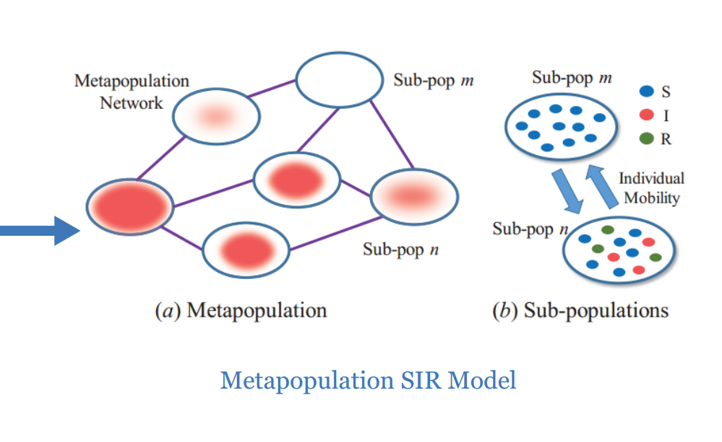
Metapopulation SIR Model
To correlate population mobility with disease transmission, we need to extend the SIR model into the Metapopulation SIR model.

Slide 11
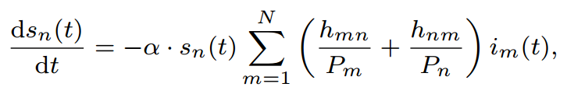
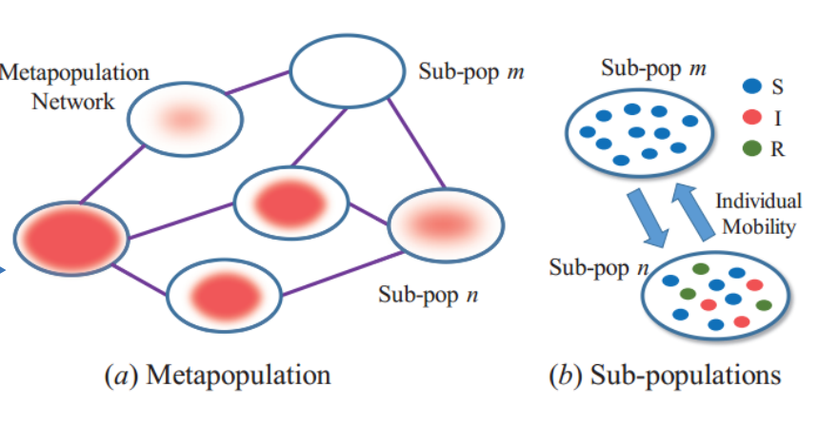
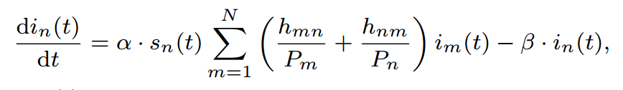
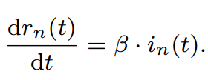
Metapopulation SIR Model
The remaining challenge is to figure out h_{mn} and h_{nm}!

Slide 12
Network Inference
Three

Slide 13
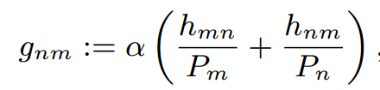
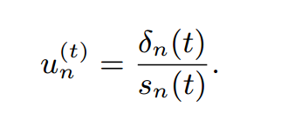
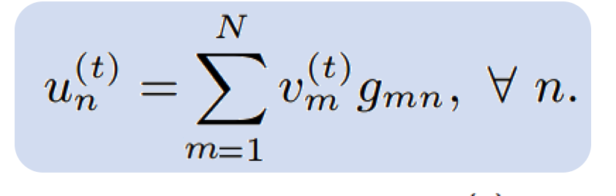
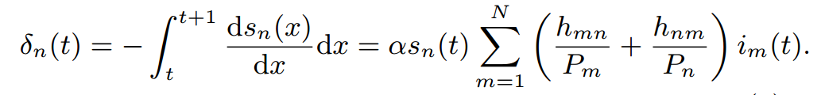
States in Metapopulation SIR Model
characterization of population mobility
Incidence Rate
new Infections in time slice t in population n

Slide 14
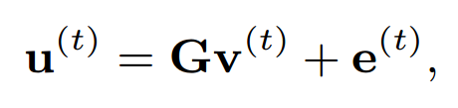
Network Inference Problem
Symmetric Network
Unknow Parameter
State Variable in t
Known Variable
Error
Random
Variable
State Variable in t
Known Variable

Slide 15
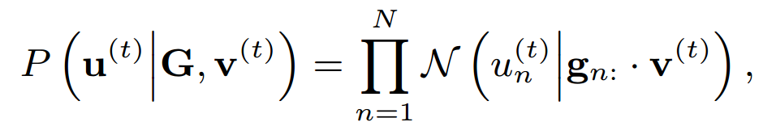
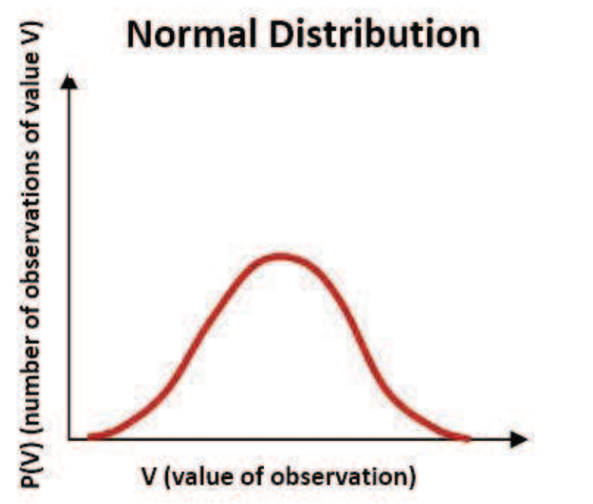
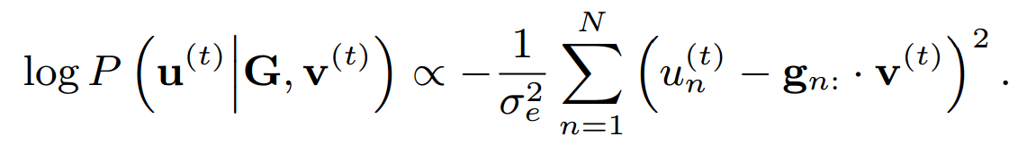
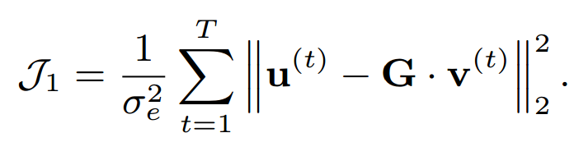
MLE Optimization
Probability Distribution
Gaussion
Distribution
Log Likelihood
Objective Function

Slide 16
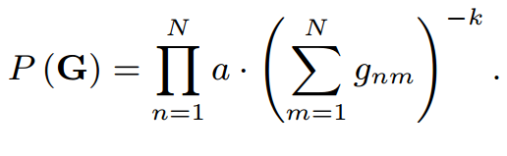
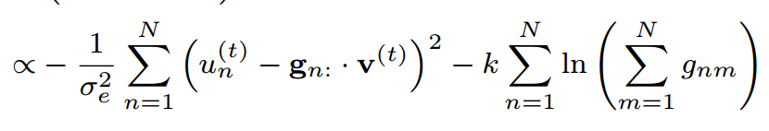
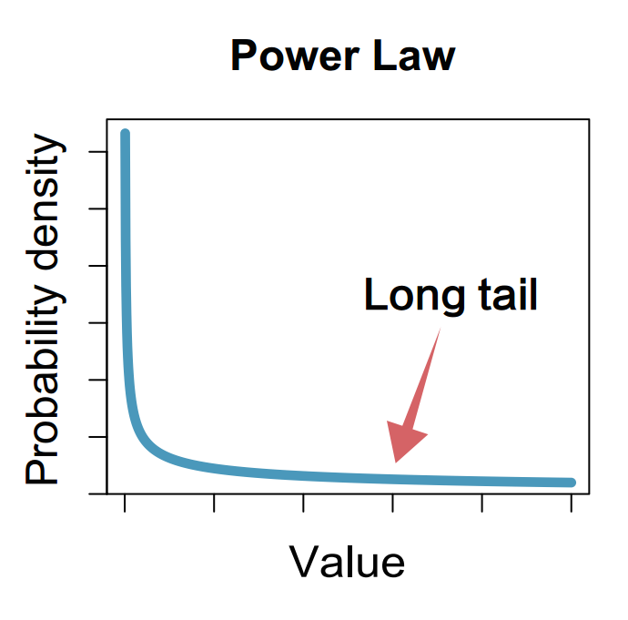
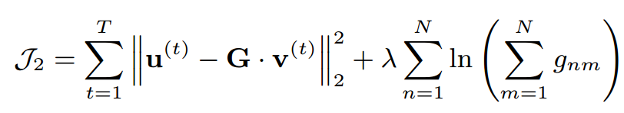
Power-Law Priori
Probability Distribution
Log Likelihood
Power-Law
Distribution
Objective Function

Slide 17

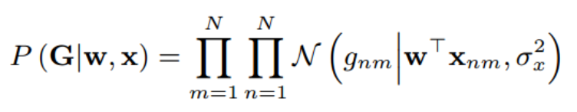
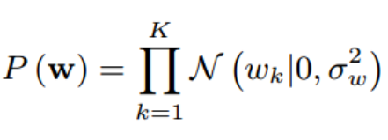
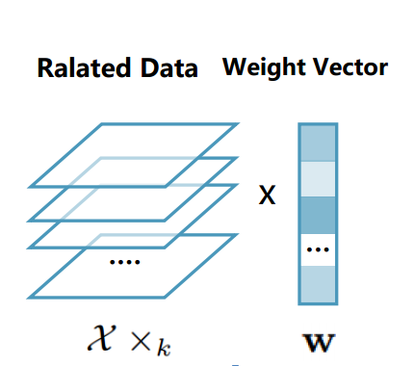
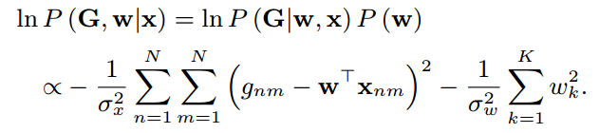

Data Priori
Probability Distribution
Log Likelihood
Objective Function

Slide 18
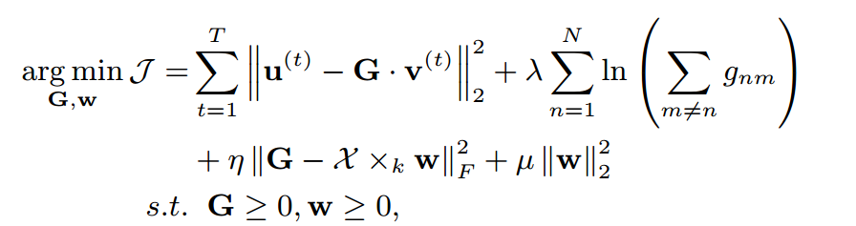
D²PRI Model
MLE
Power-Law Priori
Data Priori

Slide 19
Optimization
Gradient
Descent

Slide 20
Data Description
FOUR

Slide 21
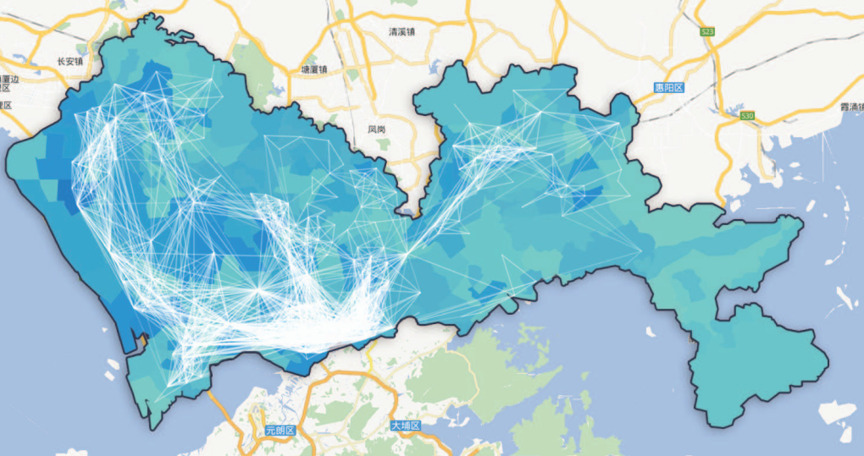
Data Description
Visualization of Shenzhen Sub-populations
Population Data
Population data of 127 administrative urban zones in Shenzhen, with over 11 million residents
Epidemic Data
Record of outpatient clinic in Shenzhen (2014.2-2014.9), 1st outbreak: March - May, 479 thou.; 2nd outbreak: May - August, 567 thou.
Behavior Data
Mobile location data in Shenzhen, one week in 2013.4
Taxi trajectory data in Shenzhen, one week in 2014.4
Location Data
Partition of more than 700 transportation analyze zones (TAZ) in Shenzhen
Daily new infections of airborne diseases

Slide 22
Experiments
Five

Slide 23
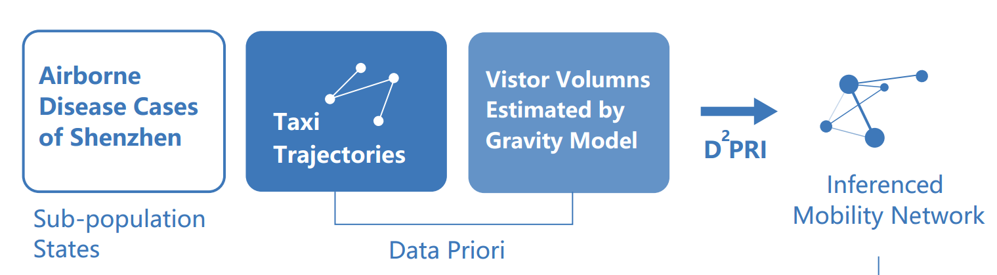
Network Inference

Slide 24
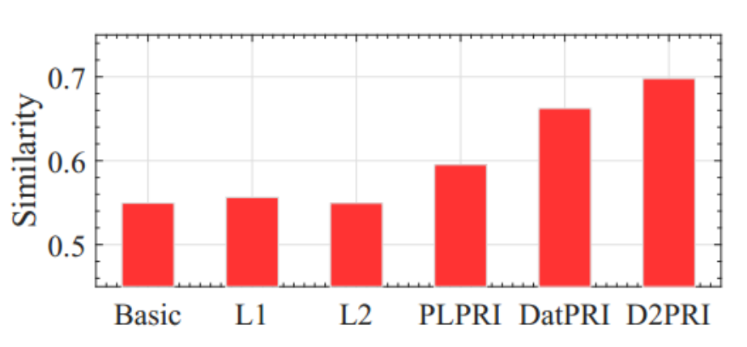
Similarity Comparison
Compare the similarity of inferenced mobility network and human mobility network extracted from the mobile phone data
D2PRI Model

Slide 25
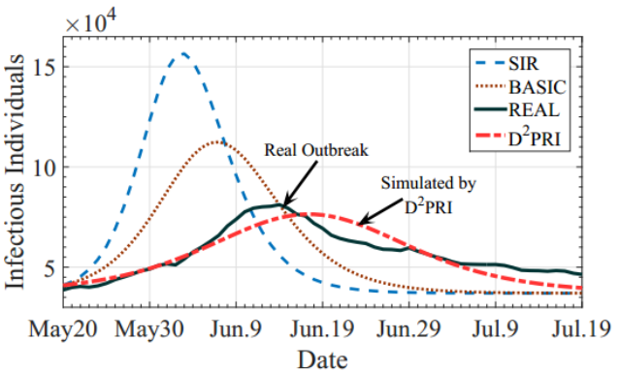
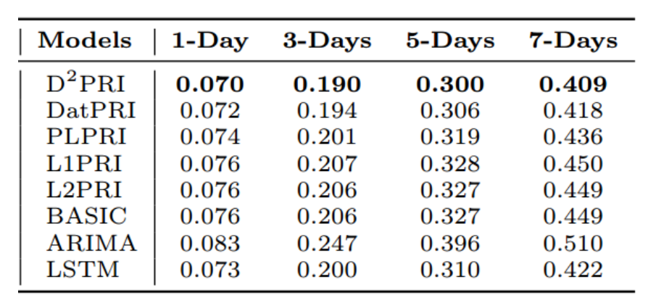
Simulation
Apply the network inferred in FirstOutbreak to predict the SecondOutbreak
Measured by MAPE

Slide 26
Key-Zone Detection
Notes:
Fig. 7(a) gives the map of importance for the urban zones in Shenzhen using the infectious number based method. The points on the map are geographic centers of urban zones, and the sizes of points denote importance level of each zone.
The two most “important” zones locate at the downtown areas of Shenzhen, where the population densities are relatively higher. After excluding the two zones, however, the importance of the remaining zones seem are very similar to each other. This type of zone importance cannot give adequate help to epidemic control and prevention.

Slide 27
Key-Zone Detection
Notes:
Fig. 7(b) gives a map of the pagerank importance. As shown in the figure, the high score zones are geographically clustered on four areas: The first is in the northwest area of Shenzhen, which is a gathering place
of industrial parks. The second is in the southwest area, which is the university town. The third is in the central region of Shenzhen, which is the headquarter of the Huawei company, the biggest high-tech enterprise in Shenzhen with more than 0.1 million employees working in the headquarter. The fourth is the Shenzhen Railway
Station, which is very close to the port between Shenzhen and Hong Kong. We can see these areas have a very similar characteristic: there are many residents, e.g., workers, students, employees, or passengers, visiting to these areas every day.

Slide 28
Conclusions
Six

Slide 29
Conclusions
A novel metapopulation based epidemic propagation model.
Power-law prior and data prior are used for network inference.
Our model can accurately infer the underlying sub-population network and predict a disease outbreak with 567 thousand infected persons in a metropolis with a population of 11 million.
Our model is adopted by the metropolis for key areas detection.

Slide 30
Extensions
Seven

Slide 31


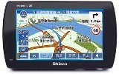
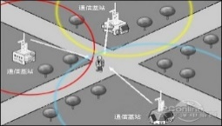

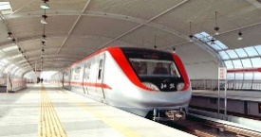

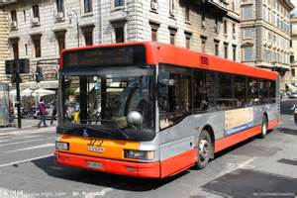
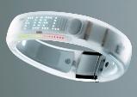

Mobile Crowd Sensing and Analytics
NSFC key project: Big Data Mining for Mobile Crowd-Sensing IOT (71531001)
Floating Car GPS Data
GPS
Mobile Signaling Data
Smart Card
Metro RFID Data
Mobile Phone
Wearable Devices
Bus RFID Data
……
Weibo Check_in Data
Mobile Sensors
Mobile Crowd Sensing
Urban Computing

Slide 32
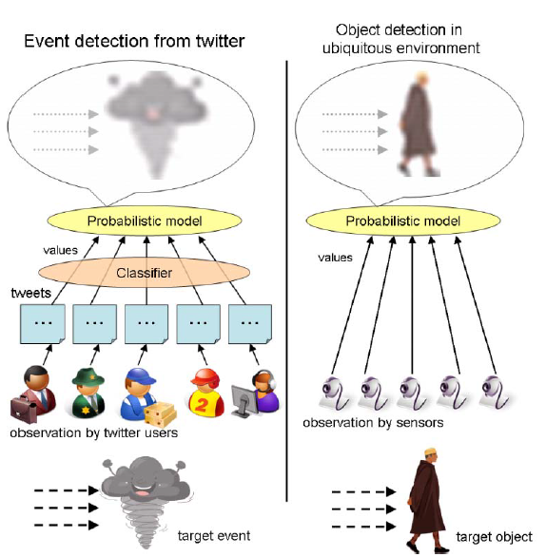
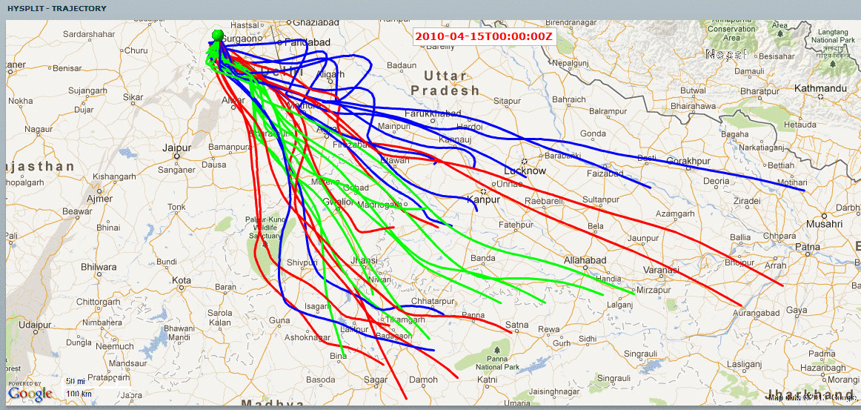

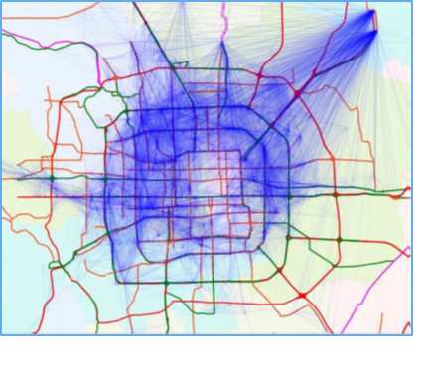
Top Challenges
1. Social Sensing
2. Spa.-temp. Modeling
3. Knowledge Maps

Slide 33
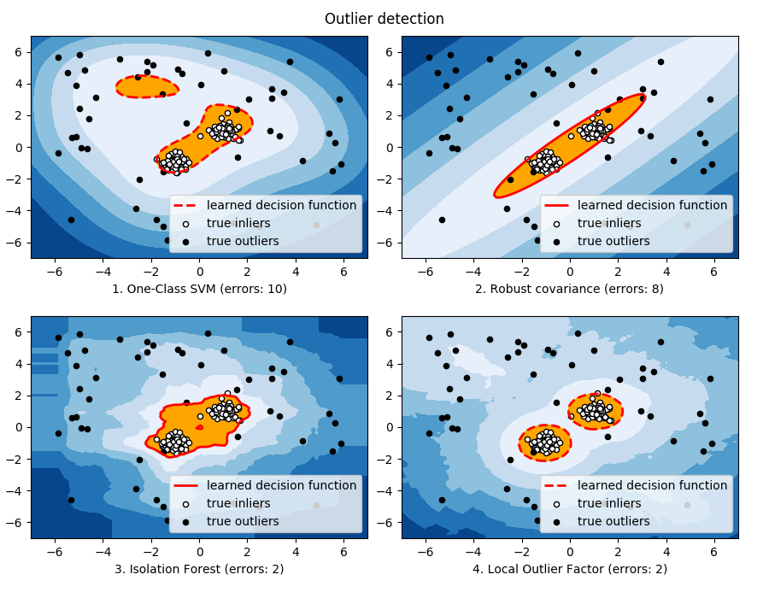
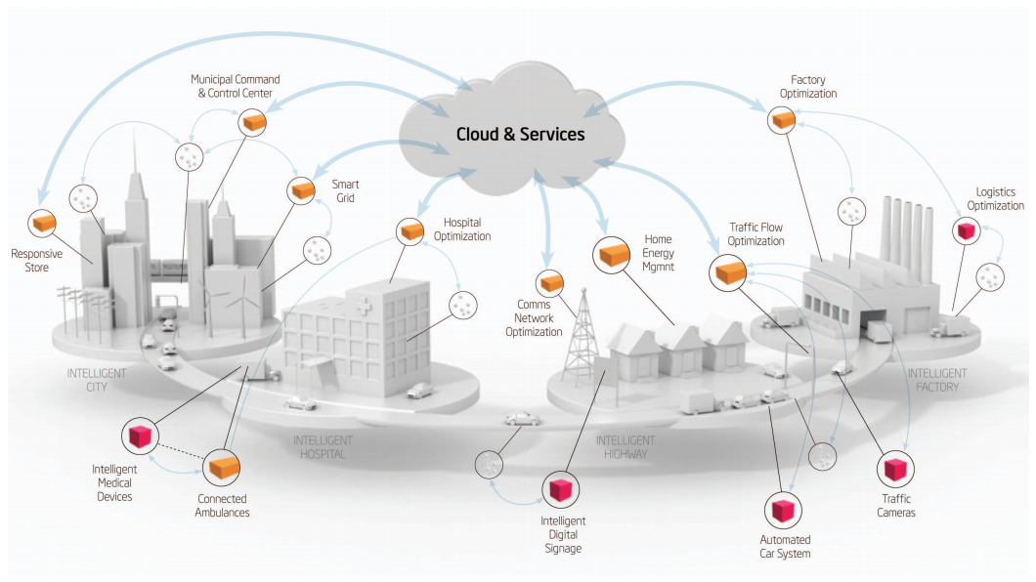

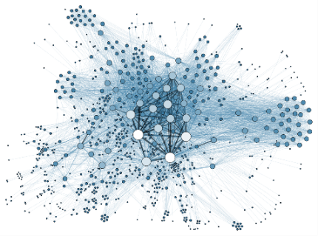
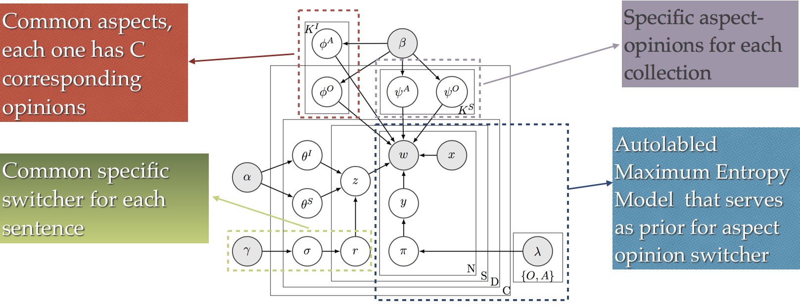
Top Challenges
4. Outlier Detection
5. Heterogeneous Data Modeling
6. Prediction-Causality Integrated Modeling

Slide 34

Jingyuan Wang, jywang@buaa.edu.cn
Beihang

